Slide 1
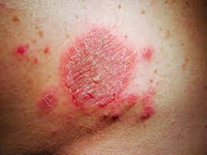
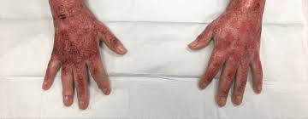
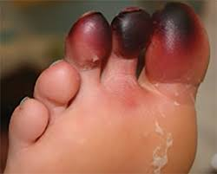
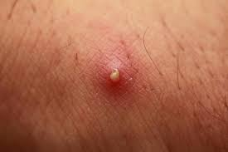
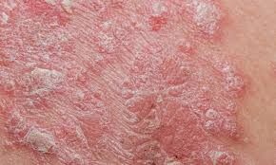
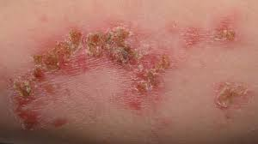
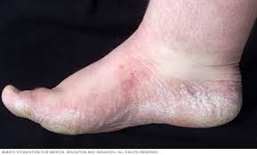
Repair and Injury
By: Josh Freeman, Rylee Steen, Kate Rucker, Sophia Klingensmith

Slide 2
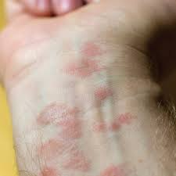
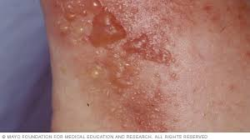
Dermatitis
What is Dermatitis?
Dermatitis is a general term that describes skin irritation. It involves itchy, dry skin or a rash on swollen, red skin.
Types of Dermatitis:
Atopic Dermatitis (Eczema): Usually beginning in infancy, this red, itchy rash usually occurs where the skin bends — most commonly inside the elbows, behind the knees and in front of the neck.
Contact Dermatitis: This red, itchy stinging rash occurs where your skin has come into contact with substances that irritate the skin or cause an allergic reaction.
Seborrheic Dermatitis: This condition causes scaly patches, red skin, and stubborn dandruff. It usually affects oily areas of the body, such as the face, upper chest, and back. Most common in infants, this skin condition is called cradle cap.

Slide 3
Dermatitis
Causes of Dermatitis:
Atopic Dermatitis: This type of Dermatitis is usually caused by not moisturizing dry skin, a gene variation, immune system dysfunctions, and when your skin comes into contact with allergens.
Contact Dermatitis: This type of Dermatitis specifically results from contact with allergens or skin irritants. Irritants and allergens include poison ivy, perfumes, scented lotions, jewelry containing nickel, and cleaning products.
Seborrheic Dermatitis: This type of Dermatitis is only caused by yeasts or fungi that are in the oil secretion on the skin.
Treatment:
Taking shorter baths or showers, using gentle soaps or cleansers, moisturizing your skin, or a prescribed lotion to treat each type of dermatitis called tacrolimus ointment.

Slide 4
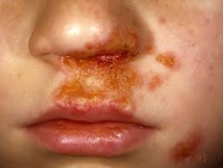
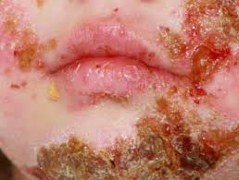
Impetigo
What is Impetigo?
Impetigo is a common, highly contagious skin condition that mainly affects infants and children. Impetigo first appears as red sores on the face, usually around the mouth or nose. Eventually, the sores burst and turn into crusted scabs.
Causes of Impetigo:
Being exposed to bacteria when you come in contact with items of someone who’s infected- clothing items, bed sheets, towels, and even toys.

Slide 5
Impetigo
Symptoms of Impetigo:
Red sores that quickly rupture, ooze for a few days and then form a yellowish-brown crust.
A less common form of Impetigo called bullous impetigo, form larger blisters that occur on the trunk of infants or young children.
A more serious form of Impetigo, called ecthyma, penetrates deep into the skin causing extremely painful, pus-filled sores that turn into deep ulcers.
Treatment:
Impetigo is usually treated with an antibiotic ointment or cream that is applied over the sores. Sometimes, for worse cases of impetigo, an antibiotic oral medicine is given.

Slide 6
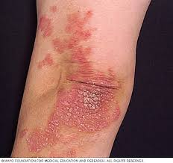
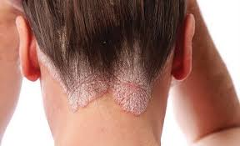
Psoriasis
What is Psoriasis?
Psoriasis is a chronic skin disease which speeds up the life cycle of skin cells.
Symptoms of Psoriasis:
Red patches of skin
Dry skin
Itching
Burning
Problems with nails
Stiff joints

Slide 7
Psoriasis
Types of Psoriasis:
Plaque Psoriasis (most common form): Dry skin lesions covered by scales.
Nail Psoriasis: Causes pitting and abnormalities in the nails.
Guttate Psoriasis (most common in children): Usually caused by a bacterial infection. It contains lesions on the scalp and trunk.
Causes of Psoriasis:
The cause of Psoriasis is not fully understood, but researchers believe that it is related to an immune system problem with T-Cells. .
Treatments:
Psoriasis is most commonly treated with topical Corticosteroids, vitamin D, and topical retinoids.

Slide 8
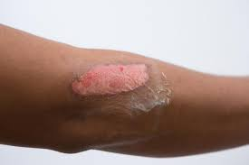
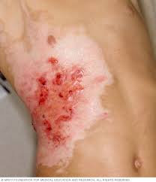
Burns
What are Burns?
Burns are tissue damage resulting from exposure to high heat.
Types of Burns:
First-Degree Burn: Only affects the outer layer of skin. These type of burns causes redness and pain.
Second-Degree Burn: Affects the first two layers of skin. The indicator of a second-degree burn is a blister.
Third-Degree Burn: The burn reaches the subcutaneous (fat) layer of the skin. The skin may appear black, brown, white, and leathery. Nerve damage is often a result of a third-degree burn which causes loss of feeling.

Slide 9
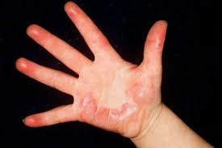
Burns
Symptoms of Burns:
Bacteria infection (sepsis)
Fluid loss
Scars
Dangerously low body temperature
Joint problems
Treatments:
Minor Burns: Soaking in water, gauze wrap, and over-the-counter pain medicine.
Major Burns: Fluids, antibiotics, pain control medicines, skin grafts, surgery.

Slide 10
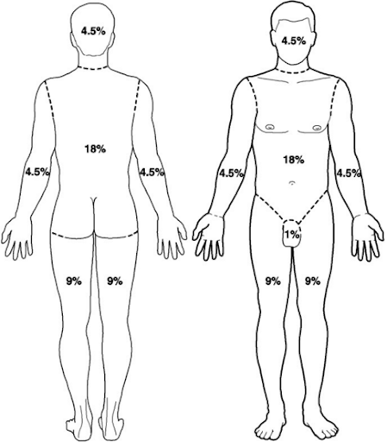
Rule of 9s (for burns)
Rule of 9s:
The rule of 9s is the technique used by healthcare professionals to estimate the amount of fluid loss and severity of a burn. This process is usually the factor that determines a transfer to a burn unit.
The rule of 9s accounts for the anterior and posterior sections of the body.
Each section of the body is a percentage in the rule of 9s.

Slide 11
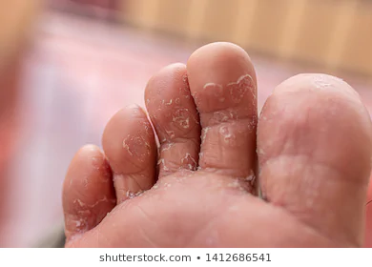
Athlete’s Foot
What is it?
A fungal infection that normally begins in between the toes.
Like most fungus, it thrives in moist areas
Causes of Athlete’s Foot:
Sharing socks, shoes, or towels with an infected person
Keeping your feet wet for long periods of time
Having sweaty feet
Having a minor skin or nail injury on your foot

Slide 12
Athlete’s Foot
Symptoms of Athlete’s Foot:
Itching, stinging, and burning between your toes or on soles of your feet
Blisters on your feet that itch
Cracking or peeling skin on your feet
Toenails that pull away from the nail bed
Treatment:
Can be treated with simple over the counter (OTC) topical antifungal medications.
Topical or oral prescription-strength antifungal medications may be prescribed as an alternative
Soaking your feet in saltwater or diluted vinegar can help dry up the blisters

Slide 13
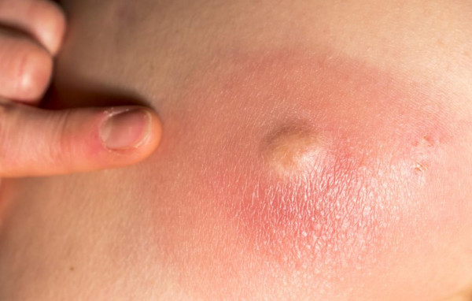
Boils
What are Boils?
A common, painful infection of a hair follicle and the surrounding skin
It begins as a red lump, then fills with pus as white blood cells rush in to fight the infection
Causes of Boils:
Ingrown hair
Result of a splinter or other material lodged in the skin
Plugged sweat glands that become infected
Most cases don't have one single cause

Slide 14
Boils
Symptoms?
Hard, red, painful, pea-sized lump
A fever may develop
Lymph nodes in the area become swollen
The skin around the area becomes red, painful and swollen
Treatment?
Incision and drainage by health care professional
Wash area with antibacterial soap
Warm compresses
Antibiotics

Slide 15
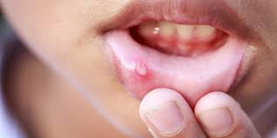
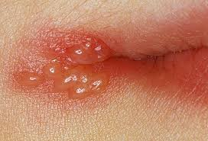
Cold Sores
What are cold sores?
Cold sores are tiny blisters that develop on the lips or mouth. They are often called fever blisters.
Causes:
They are caused by the herpes simplex virus strain
HSV-1. It can be transmitted through close contact or drinking after someone.

Slide 16
Cold Sores
Symptoms:
Burning sensation
Itching
High body temperature
Sore throat
Treatment:
There is no cure, but these things may be beneficial:
Antiviral creams, painkillers, OTC creams

