Slide 1
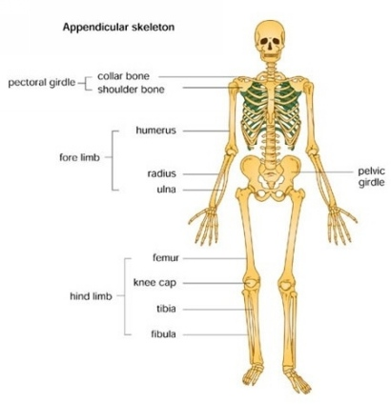
Appendicular Skeleton

Slide 2
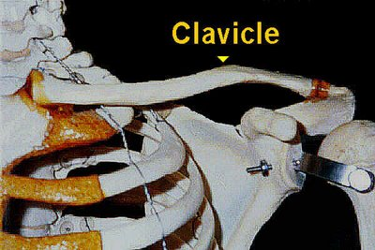
Appendicular Skeleton Upper Limbs (Top Half)
I. Shoulder Girdle/ Pectoral Girdle
A. Clavicle (collar bone) → attaches to the sternum and scapula
Scapula (shoulder blade) → triangular shaped, “wings”; flare with mov’t; attaches to clavicle and top of shoulder.

Slide 3
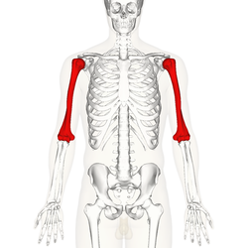
Appendicular Skeleton (Top Half)
II. Upper Limbs (30 bones)
Arm
1. Humerus (upper arm) → long bone that attaches to the scapula
2. Radius (larger bone in forearm) → attaches to thumb
3. Ulna ( smaller bone in forearm) → medial bone at anatomical position

Slide 4
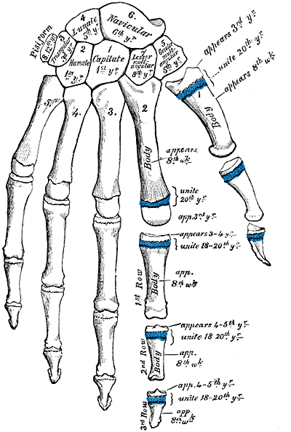
Hand
Carpals (8 bones make up the wrist) → two irregular rows of 4 bones each
Metacarpals (knuckles) → makes up the back of hand
Phalanges (fingers) → 14 on each hand; 3 on each finger; a proximal, medial and distal *** thumb only has 2!

Slide 5
Bottom half… Pelvic girdle and lower limbs
Lower Limbs
Coxa= hip bone ( 3 fused bones)
Ilium= hip ( large for attachment of muscles and ligaments)
Ischium = back/ posterior ( wt. is on when seated)
Pubis= front→ pubic symphysis ( cartilage) has acetebelum” cup” for head of femur

Slide 6
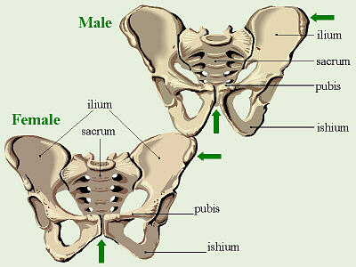
Male vs. Female???

Slide 7
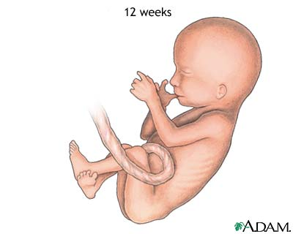
Pelvis!
Pelvis– is shaped differently in males and females due to size and muscle mass
a. Female has a. enlarged pelvic outlet
b. Less curvature of sacrum and coccyx
c. Wider and more circular outlet
d. Broader pubic arch/ greater than 100degrees
** All of the above helps support wt. of fetus and passage of fetus through sacral canal

Slide 8
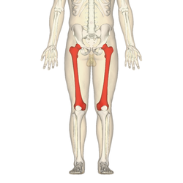
Lower Limbs!
Femur= longest and heaviest bone in the body, has large articular cartilage surface for patella
Patella= knee cap, lg. sesamoid bone: facets articulate with condyles of femur
Tibia= large bone of lower leg; anterior crest can be “palpated” through skin
Fibula= slender; doesn’t articulate with femur and does not play a role in transfer of wt. to foot.

Slide 9
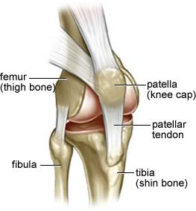
Patella

Slide 10
The Foot
Ankle ( tarsus) = 7 tarsals
Calcaneus= heel bone ( large/ holds most of wt.) has a calcaneal tendon ( Achille’s tendon) allows you to raise toes and depress sole→ walk!
Foot→ metatarsals ( 5 long bones) → sole of foot.
Phalanges= toes ( 14 of them) proximal, medial and distal, big toe = hallux

