Slide 1
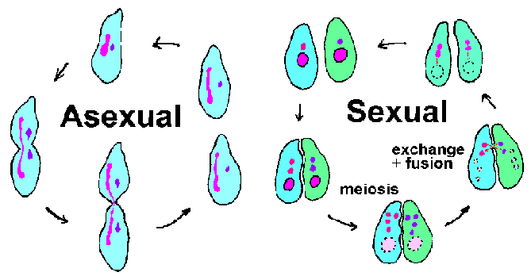
Asexual vs. Sexual Reproduction

Slide 2
Match it Up- From your prior knowledge, match up the two types of reproduction with their characteristics and place the items a the Venn Diagram on your loose leaf paper.
Reproduction Type
Sexual reproduction
Asexual reproduction
Characteristics
Two parents
Identical offspring
One parent
Not identical offspring
Passes on DNA to from parent to offspring
Bacteria, protists, some plants, yeast
Fish, Mammals, Amphibians, Birds, Reptiles, Insects

Slide 3
Make a Venn Diagram
Asexual Reproduction
Sexual Reproduction
Both
Types of reproduction in living organisms
Pass DNA from parent to offspring

Slide 4
Picture Play-
Make a two columns on your paper… label one Sexual and one Asexual
Look at each picture and decide whether it demonstrated asexual or sexual reproduction. Write the number under the column.

Slide 5
1. Mitosis

Slide 6
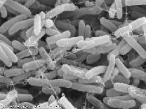
2. Binary Fission

Slide 7
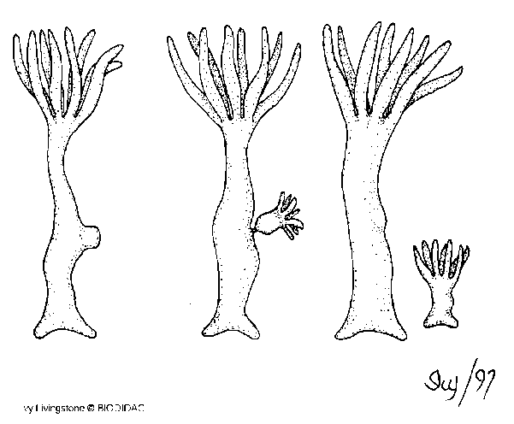
3. Budding

Slide 8
4. Spores

Slide 9
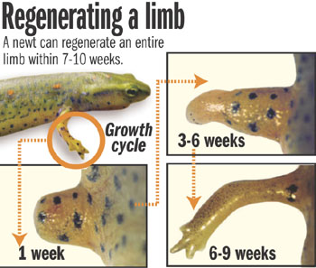
5. Regeneration

Slide 10
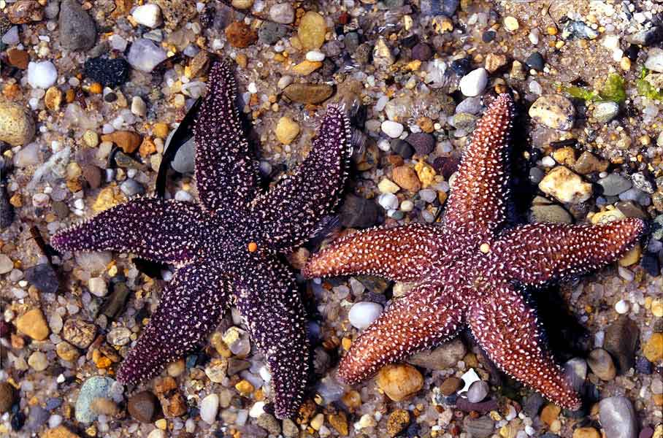
6. Fragmentation

Slide 11
7. Propagation

Slide 12
8. Insects

Slide 13
9. Fish

Slide 14
10. Flowers

Slide 15
11. Birds

Slide 16
Now let’s go back and fill in
Some notes about each one….

Slide 17
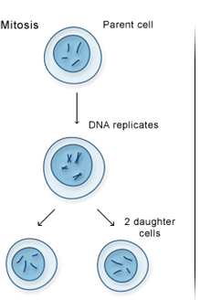
Asexual Reproduction
Requires only one parent
Offspring have 100% the same chromosomes as the parent.
In other words, the offspring are exact “clones” of the parent.
Most unicellular organisms
reproduce this way.
#1 Mitosis
Movie

Slide 18
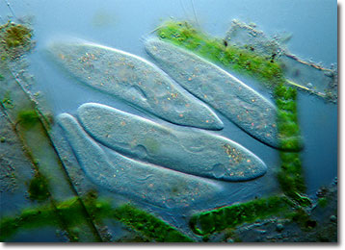
Asexual Reproduction
#2 Binary Fission
Bacteria
Protists
Binary fission is a form of asexual reproduction where every organelle is copied and the organism divides in two.

Slide 19
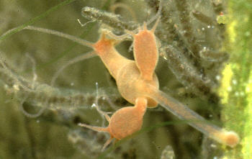
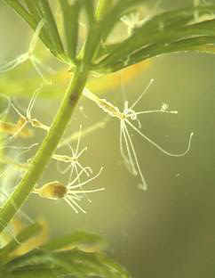
Asexual Reproduction
#3 Budding
Hydra
Movie
Budding is a means of asexual reproduction whereby a new individual develops from an outgrowth of a parent, splits off, and lives independently.

Slide 20
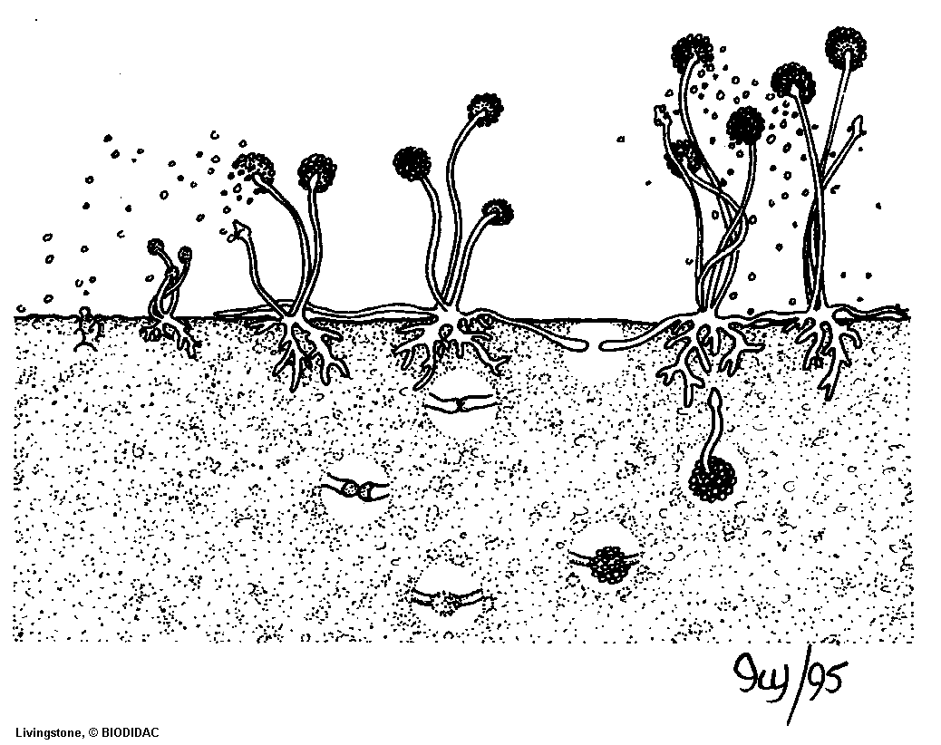
Asexual Reproduction- #4 Spores
Found in fungi, algae, protozoa
Airborne cells that are released from the parent. They are enclosed and developed when the environment is appropriate

Slide 21
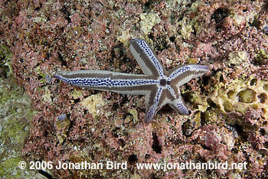
Asexual Reproduction
#5 Regeneration
Regeneration occurs when a body part has broken off and the organism grows a new one.

Slide 22
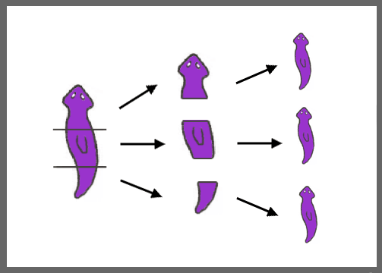
Asexual Reproduction
#6 Fragmentation
Fragmentation is a means of asexual reproduction whereby a single parent breaks into parts that regenerate into whole new individuals.

Slide 23
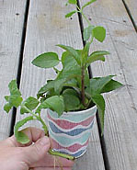
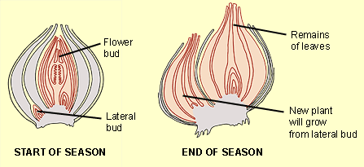
Asexual Reproduction
#7 Plant cuttings/ vegetative propagation
Vegetative reproduction is a type of asexual reproduction in plants that relies on multi-cellular structures formed by the parent plant. It has long been exploited in horticulture and agriculture, with various methods employed to multiply stocks of plants.

Slide 24
Asexual reproduction- Mitosis
The process where animal cells divide
This is a type of asexual reproduction
Body cells (somatic cells) go through the process of mitosis
Results in an exact copy of the parent cell

Slide 25
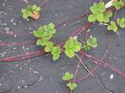
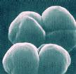
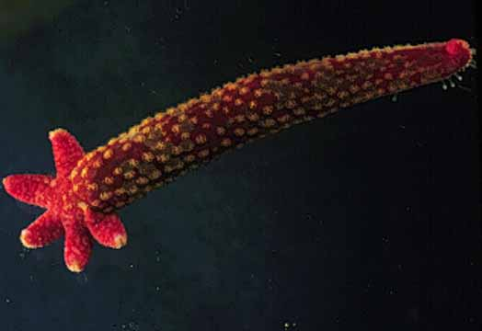
Asexual Reproduction
Examples of organisms that reproduce asexually
Hydra
Sea Star
Archaebacteria
Eubacteria
Euglena
Paramecium
Yeast

Slide 26
Mitosis Brain Pop
http://glencoe.mcgraw-hill.com/sites/dl/free/0078768349/164155/00053413.html

Slide 27
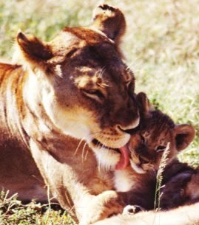
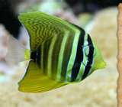
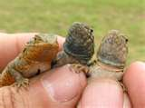
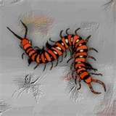
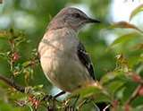
Sexual Reproduction
The Animal Kingdom
Fish
Mammals
Amphibians
Birds
Reptiles
Insects
Crustaceans

Slide 28
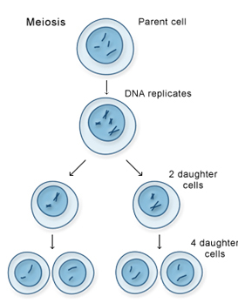
Sexual Reproduction
Requires two parents that each share ½ of the genetic information.
Offspring share the characteristics of each parent.
Meiosis

Slide 29
Advantages vs Disadvantages of Asexual Reproduction
Advantages
Disadvantages
Asexual reproduction produces more offspring
Asexual reproduction takes less time
Only one parent involved. No searching for mates
Requires less energy
Same DNA being passed down→ NO GENETIC VARIATION IN THE OFFSPRING
If parent has genetic disease offspring will have it too

Slide 30
Advantages vs Disadvantages of Sexual Reproduction
Advantages
Disadvantages
Variation in offspring
Organism is more protected because of genetic variation
Requires two organisms. Must find a mate
requires more cellular energy
More time required for offspring development

Slide 31
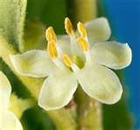
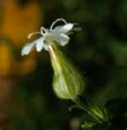
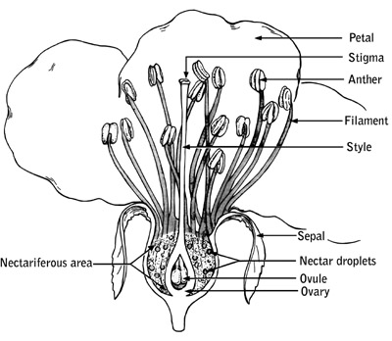
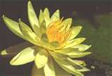
Sexual Reproduction
Plant Kingdom
Flowers are the reproductive organs of plants.
Some flowers have both male and female reproductive organs on the same flower.
Male flower
Female flower

Slide 32
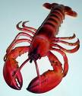
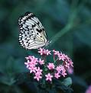
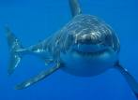
Sexual Reproduction
Examples of organisms that reproduce sexually
Chickens
Iguanas
Lobsters
Sharks
Humans
Butterflies
Sunflowers
Roses

Slide 33
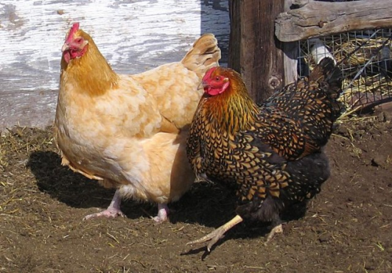
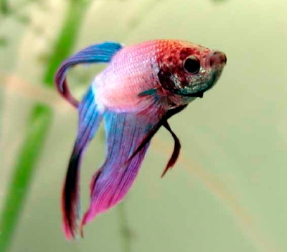
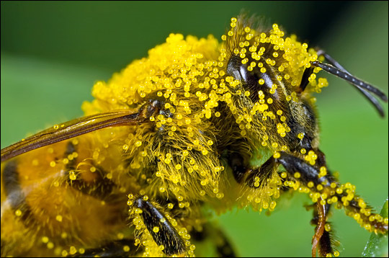
Sexual Reproduction
2 Types
Internally (inside)
The egg is fertilized by sperm inside the female
Mammals, birds, reptiles, insects, spiders
Externally (outside)
The egg is fertilized by sperm outside the female
The female lays the eggs and then the male fertilizes them.
Fish and some amphibians
Plants and fungi (pollen and spores)

Slide 34
Summarize
Write two paragraphs with 6 sentences each describing asexual and sexual reproduction.
Paragraph 1: Asexual reproduction is…..
Paragraph 2: Sexual reproduction is…

