Slide 1
Cell Specialization
What does it mean to be specialized?

Slide 2
When you see each cell type, observe the STRUCTURE.

Slide 3
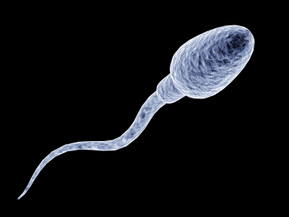
Example

Slide 4
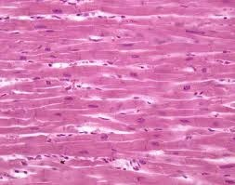
1

Slide 5
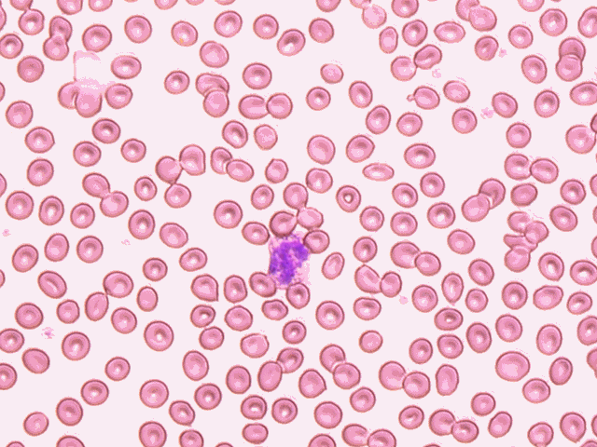
2

Slide 6
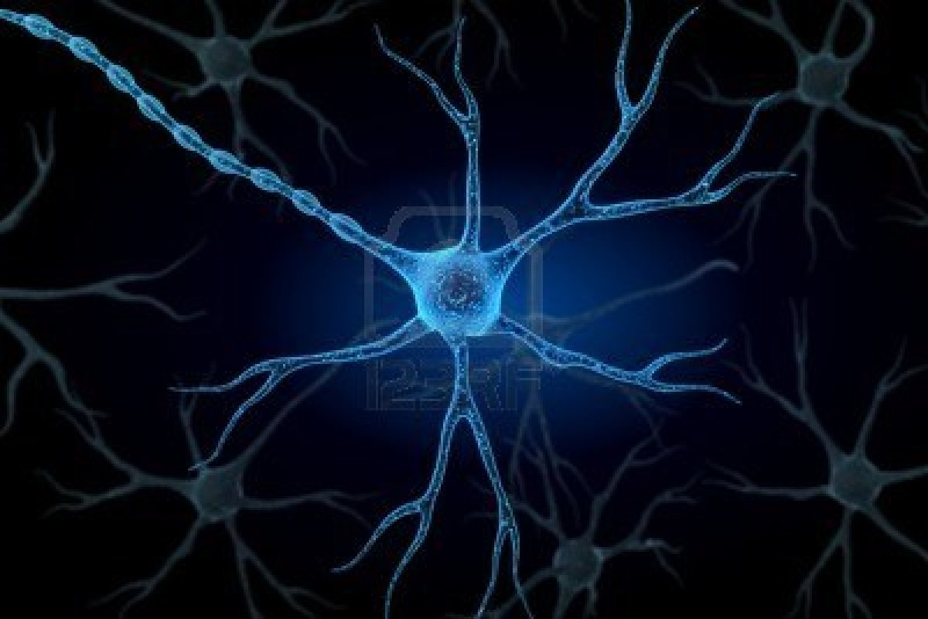
3

Slide 7
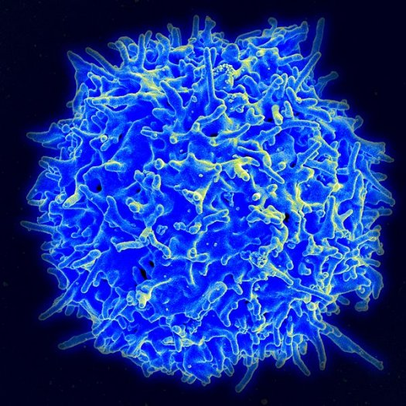
4

Slide 8
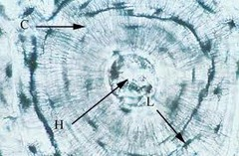
5

Slide 9
6
http://www.youtube.com/watch?v=pahUt0RCKYc

Slide 10
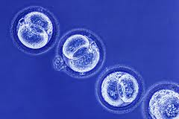
Extra

Slide 11
Structure matches the function! Match the following functions with each cell type based on their structure.

Slide 12
Carry impulses from the brain all over the body.
Support and movement. Rigid. Strong due to layers. Offer protection for more delicate organs.
Carry oxygen to organs through blood vessels.
Used for movement. Created to flex and stretch over surfaces and to move bone. Contain LOTS of mitochondria for energy.
Store excess water and pump it out to prevent single celled organisms from exploding.
Move through blood vessels to seek out infection and invaders. They recognize them and destroy them.

Slide 13
Re-create:
Cell # | Observations | Cell Type | Function | Location in the organism.
Ex. | Tail | Sperm | Moving DNA to egg | testis
1 | Layered, close together | Muscle | Used for Movement | Entire body
2 | Round, looks like “smarties” | Red Blood Cell | Carry Oxygen | Blood vessels
3 | Looks like antennae | Nerve Cell (neuron) | Carry Impulses | Entire body
4 | Looks like a “Squeezie stress ball” | Immunity Cell | Seek out infection and invaders | Blood vessels
5 | Looks like tree rings, hard circles | Bone Cell (osteocyte) | Support and Movement | Entire body
6 | Looks like it is a pump | Contractile Vacuole | Store excess water and pump | Cytoplasm of single cell
Special | Bubbles, empty, round, plain | Stem Cell | Undifferentiated Cell-can become anything !!! | Bone Marrow, Embryo, Umbilical cord

Slide 14
Define adaptation.

Slide 15
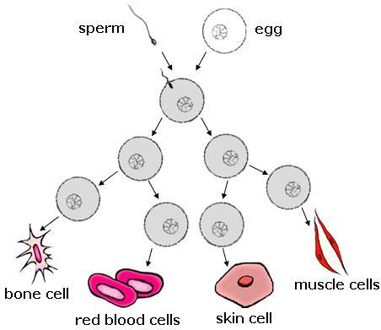
Stem Cells
Draw the picture below.
Are sperm and egg stem cells? Circle the cells that are undifferentiated stem cells.

Slide 16
Now, answer these questions.
1. Muscle cells found in the heart contain many more mitochondria than cells that store fat in adult humans. Which explanation best explains why that is true?
a. Heart muscle cells are larger than fat cells.
b. Heart muscle cells require a lot of energy.
c. Cells that compose fatty tissue are not living.
d. Cells that compose fat tissue do not make proteins.

Slide 17
2. If most of an organism’s cells have the same DNA, why is it true that all cells do not make the same proteins?
because of chromosome pairing
because of DNA mutation
c. because of differentiated ribosomes
d. because of gene (DNA) regulation

Slide 18
3. Each body cell in a human contains the same DNA, but heart cells and liver cells have different functions. Why is this true?
a. Heart tissue develops before liver tissue.
b. Liver tissue develops before heart tissue.
c. When heart cells divide, mutations occur.
Heart cells express different genes than liver
cells.

Slide 19
Thinkables: Submit answers to google classroom
Obviously, the way a cell looks is different depending on the function. Do you think a cell will have differences in organelles depending on the function of that cell? Explain your answer. What organelle(s) would muscle cells need a lot of?
All cells have a phospholipid bilayer as a cell membrane. Thinking about the variety of shapes and sizes of cells what can you conclude about the cell membrane?
True/False: The nucleus of a cell contains different types of DNA depending on the structure and function of the cell for that organism. Explain your answer.
How/Where do you get the different cells in your body?

