Slide 1
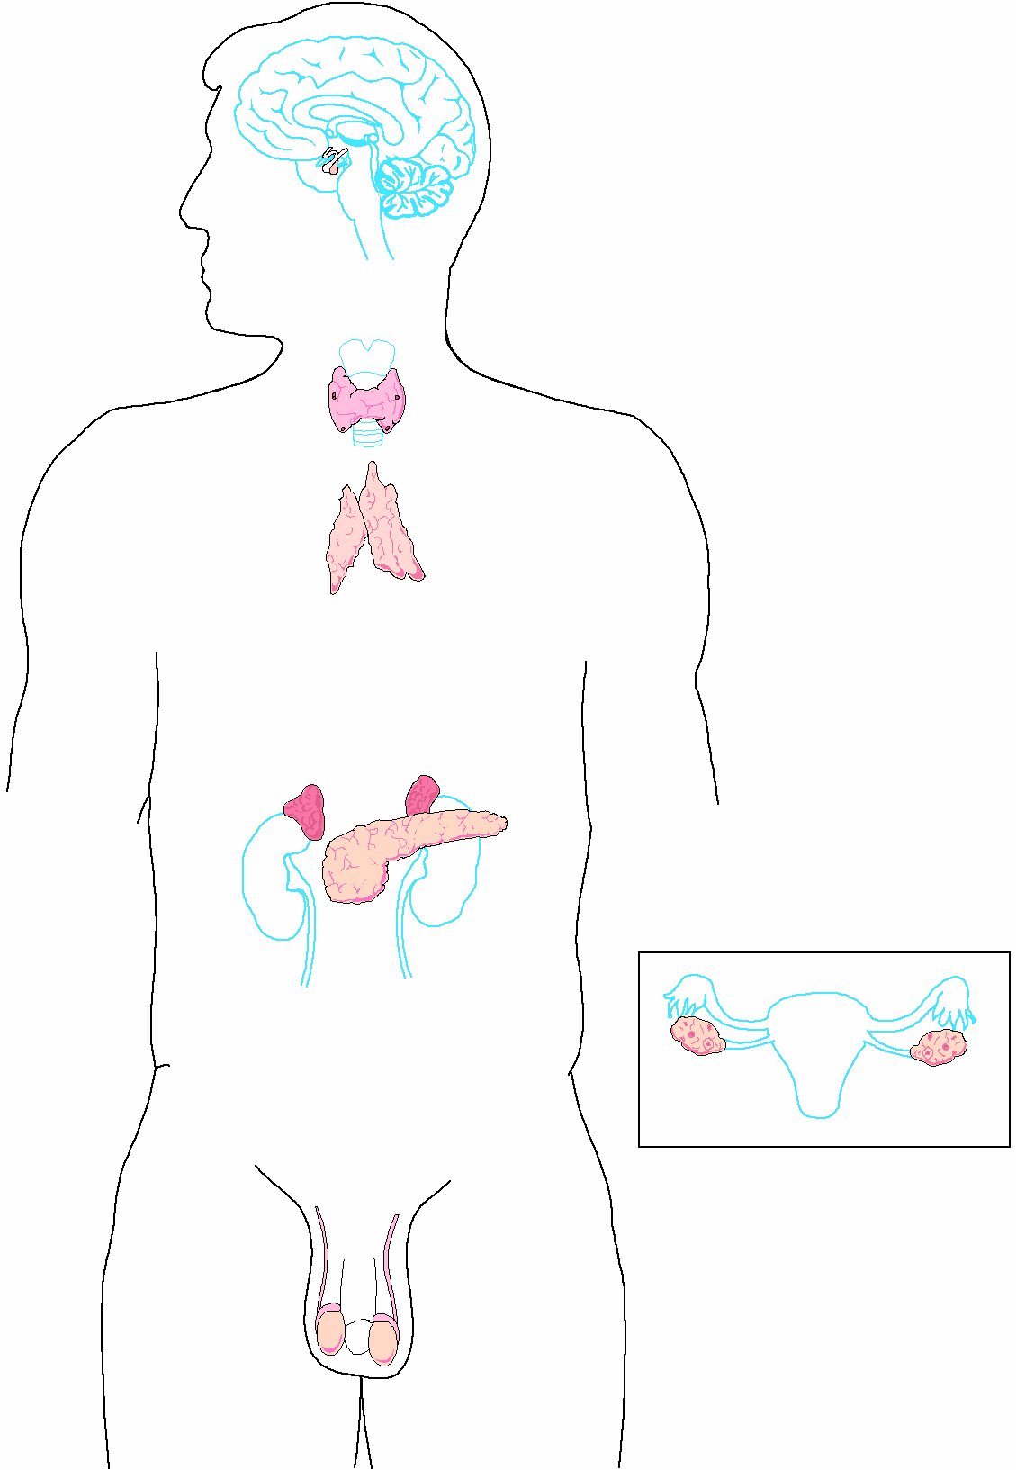

Slide 2
Endocrine System Introduction Video
Chapter 11

Slide 3
Endocrine system
Function of the Endocrine System – to secrete hormones – chemical messengers that coordinate and direct target cells and organs.

Slide 4
ENDOCRINE GLANDS
• Secrete hormones directly into bloodstream
• Ductless
Control the rate of certain chemical reactions
Transports substances across cell membranes
Helps regulate water and electrolyte balances
Play a vital role in reproduction, development, and growth

Slide 5
EXOCRINE GLANDS – secrete substances through a duct (sweat, salivary, lacrimal and pancreas)

Slide 6
Hormonal control
NEGATIVE FEEDBACK
Drop in hormone level triggers a chain reaction to increase secretion, for example
Blood level of hormone falls
Brain gets message and sends out hormone to stimulate gland
Gland stimulates more hormone
When blood levels of hormone increase, the brain hormones stop

Slide 7
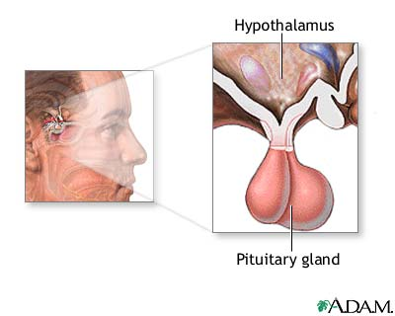
PITUITARY GLAND
Tiny structure the size of a grape
Located at the base of the brain
Connected to the hypothalamus
Divided into anterior and posterior lobes
The “Master Gland”

Slide 8
Anterior Pituitary Lobe
GROWTH HORMONE – GH (SOMATOTROPIN) responsible for growth and Development
PROLACTIN – develops breast tissue, stimulates production of milk after childbirth
THYROID-STIMULATING HORMONE – TSH - stimulates thyroxine
ADRENOCORTICOTROPIC HORMONE – ACTH – stimulates adrenal cortex
FOLLICLE-STIMULATING HORMONE – FSH - stimulates growth of graafian follicle and production of estrogen in females, sperm in males
LUTEINIZING HORMONE – LH – stimulates ovulation and formation of corpus luteum, which produces progesterone in females

Slide 9
Posterior Pituitary Lobe
VASOPRESSIN – converts to ADH (antidiuretic hormone) in the bloodstream, acts on kidney to concentrate urine and preserve H2O in the body
OXYTOCIN – released during childbirth causing contractions of the uterus

Slide 10
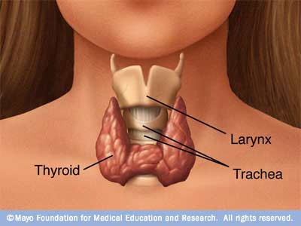
THYROID GLAND
Butterfly-shaped mass of tissue, On either side of larynx, over trachea
H-shaped
Main hormone – THYROXINE – is controlled by the secretion of TSH
Thyroxine controls the rate of metabolism
CALCITONIN – controls calcium ion concentration in the body, prevents hypercalcemia

Slide 11
PARATHYROID GLANDS
Four glands, each the size of a grain of rice
Attached to posterior thyroid
Produce PARATHORMONE which helps control blood calcium level, prevents hypocalcemia

Slide 12
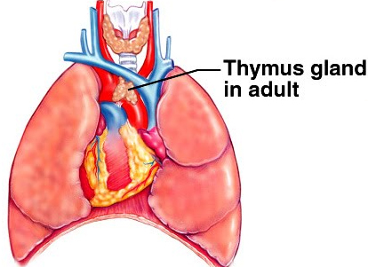
THYMUS
Endocrine gland and lymphatic organ
Located behind the sternum, above and in front of the heart
Begins to disappear at puberty

Slide 13
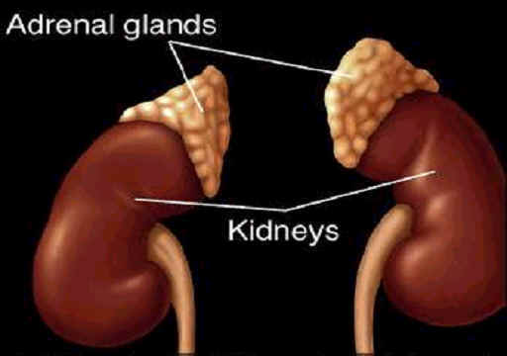
Adrenal Glands

Slide 14
ADRENAL GLANDS
Located on top of each kidney
Adrenal cortex secretes hormones known at corticoids – they are anti-inflammatory
They are: mineralcorticoids, glucocorticoids, and sex hormones
ANDROGENS are male sex hormones
Adrenal medulla secretes epinephrine (adrenaline) and norepinephrine
ADRENALINE is a powerful cardiac stimulant – “fight or flight” hormones that prepare the body for an emergency situation

Slide 15
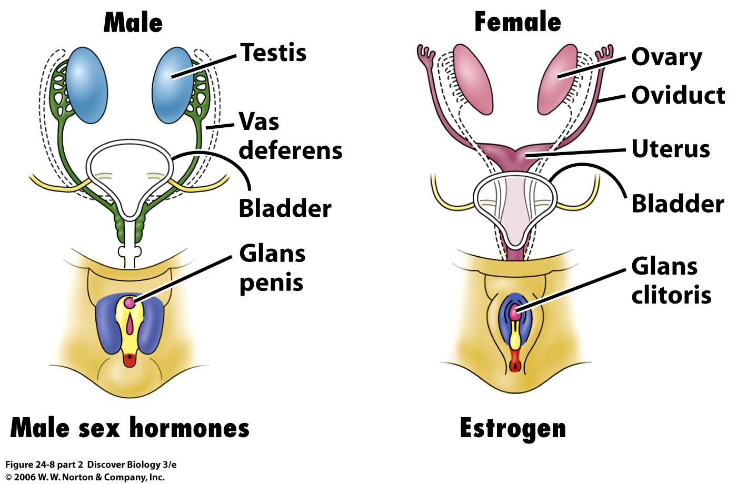
Gonads

Slide 16
GONADS
Ovary in female
Testes in male
Estrogen – development of female reproductive organs, secondary sex characteristics
Progesterone – plays a part in the menstrual cycle
Testosterone – male reproductive organs and secondary sex characteristics

Slide 17
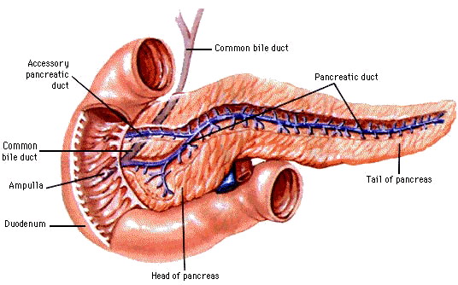
Pancreas

Slide 18
PANCREAS
Located behind the stomach
Endocrine and exocrine functions
Involved in production of INSULIN by ISLETS OF LANGERHANS
Insulin – promotes utilization of glucose by the cells, fatty acid and amino acid transport, and facilitates protein synthesis

Slide 19
Reproductive Systems
Female and Male Reproductive systems

Slide 20
