Slide 1
Enzymes
Speeding up chemical reactions

Slide 2
Energy
Activation energy is the energy required for a reaction to take place
Endothermic reactions finish with more energy than they started with; these reactions REQUIRE energy
Exothermic reactions finish with less energy than they started with; these reactions release energy

Slide 3
Enzymes
A catalyst: speeds up the rate of a reaction
An enzyme is a protein catalyst that helps a reaction happen more quickly

Slide 4
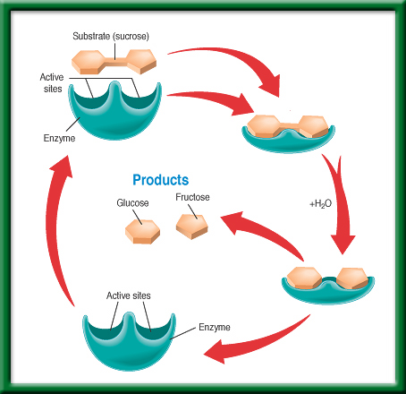
An enzymatic reaction

Slide 5
Denaturing
An enzyme becomes denatured when the bonds within it are broken due to a change in:
Temperature
pH

Slide 6
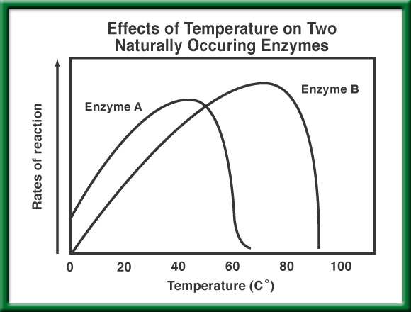
Question 1
Which enzyme performs more efficiently at a temperature of 40°C?
A or B

Slide 7
Question 2
At what temperature does Enzyme A denature?
A. 20°C
B. 65°C
C. 80°C
D. 90°C

Slide 8
Question 3
At what temperature is Enzyme B most efficient?
A. 20°C
B. 65°C
C. 80°C
D. 90°C

