Slide 1
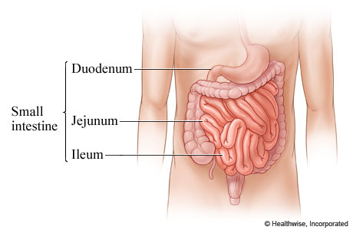
From Small Intestines to Anus

Slide 2
III. Small Intestines
A. Major Characteristics
1. 6 m. (20 ft. ) long; 4 cm to 2.5 cm in diameter
**** 2. 90% of nutrient absorption occurs here
B. 3 Subdivisions→ all attached to mesenteries
1. duodenum-- “ mixing bowl” receives chyme & enzymes from pancreas and liver
***2. jejunum-- bulk of chemical digestion & nutrient absorption occurs here
3. ileum -- empties into the lg. intestine
C. Internal Structures → help increase Surface Area by 600X!
1. villi- sm. Fingerlike projections
2. microvilli-- on villi: like bristles on a brush
WATCH VIDEO LINKED…In the Small Intestines

Slide 3
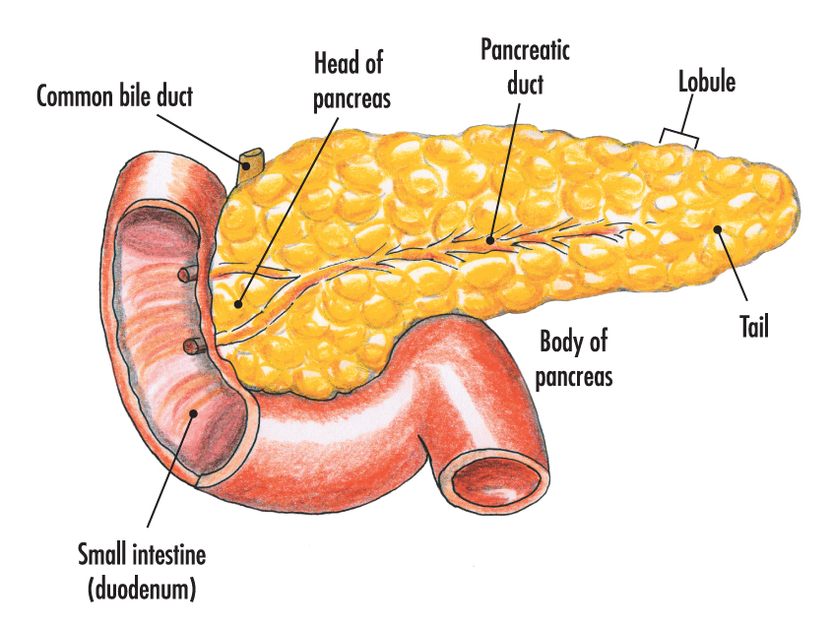
IV. Pancreas
A. Major Characteristics
1. lies btwn. the stomach, duodenum and spleen
2. lumpy, and pinkish from blood vessels
3. exocrine gland creates enzymes and 1000ml of buffers (pH of 7.5 – 8.0)
B. Major Function = secretes insulin, glucagon and enzymes into blood

Slide 4
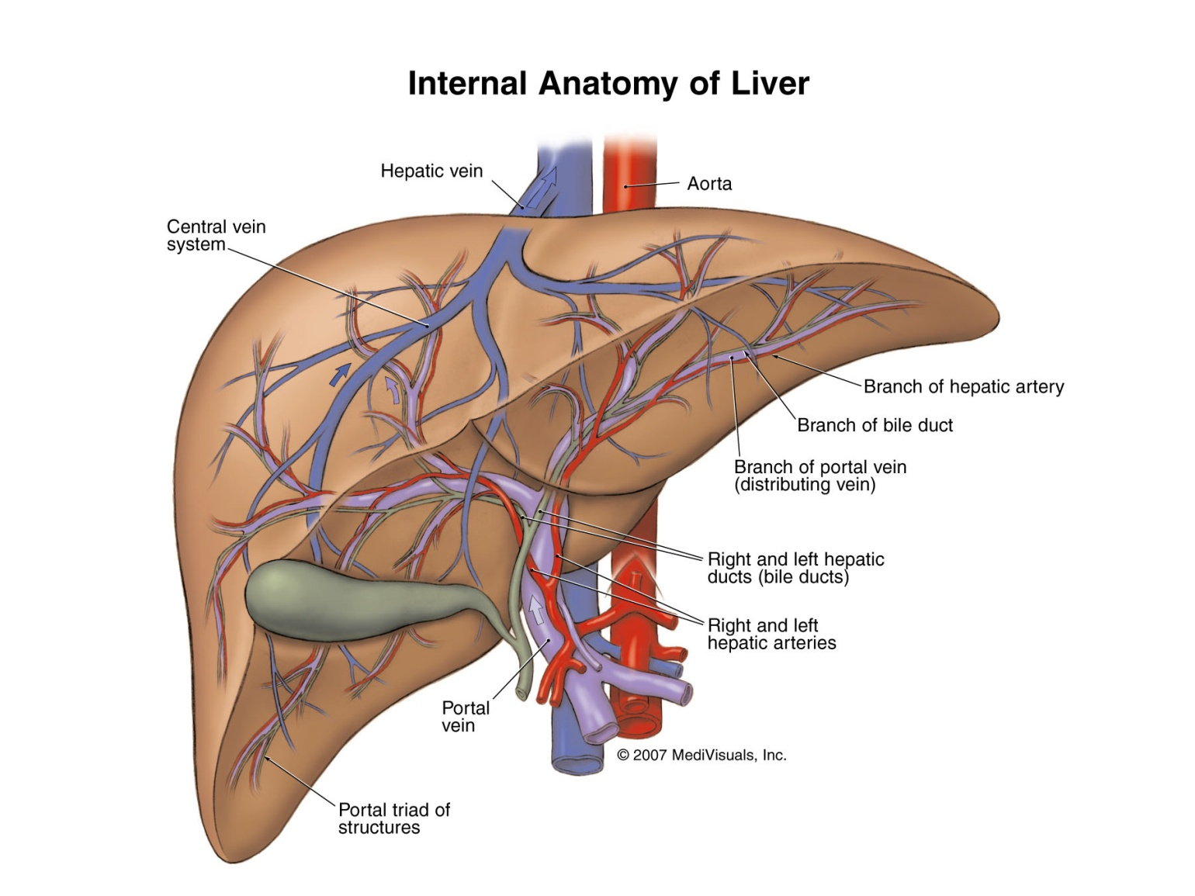
WATCH LINK…Liver!

Slide 5
V. Liver: WATCH HYPERLINKInto the Blood stream
A. Major Characteristics
1. largest organ; 3.3 lb, reddish-brown
2. essential for metabolism
B. Structure
1. Hepatic Portal Arteries and Veins → transports blood to and from liver
2. made of 100, 000 liver lobules with hepatocytes
3. Common Bile Duct = from gall bladder (w/bile) to pancreas ( enzymes) to duodenum

Slide 6
Liver continued!
C. Physiology → over 200 different functions
1. Metabolic Regulation
a. maintains blood glucose levels @ 90mg
b. regulates lipid and protein metabolism
c. **removes waste products like urea
d. stores fat soluble vitamins and minerals like A, D, E, K, B₁₂, Fe
e. removes drugs!
2. Regulates Composition of Blood
a. phagocytes eat dead or old RBC’s
b. Plasma synthesis
c. removes hormones, antibodies and toxins!
d. ** makes and secretes bile
e. Function of Bile → emulsification!! –>
breaks down fats into sm. Droplets to increase SA!

Slide 7
D. Liver Diseases
1. cirrhosis→ turns hard (fibrosis/ scar tissue
2. hepatitis→ viral , bacterial, or Sexual
3. alcoholism→ liver gets hard from always having to remove toxins from blood
VI. Gall Bladder
A. Major Characteristics →hollow, green and pea shaped
B. Gall Stones = salts become hard and block bile duct

Slide 8
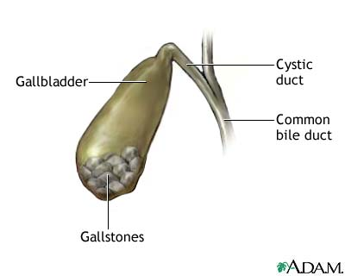
VI. Gall Bladder

Slide 9
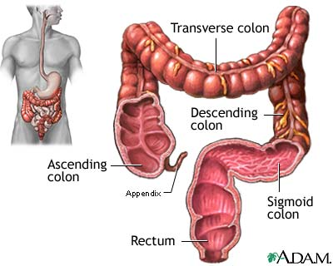
Large intestines

Slide 10
VII. Large Intestine WATCH HYPERLINK Functions!
A. Major Characteristics
1. horseshoe shaped; reabsorbs water; stores feces
2. avg. length = 1.5 m/ 5ft!
3. avg. width = 7.5 cm ( 3in)
4. no villi; much thinner walls than sm. Int.
B. Major Parts
1. Cecum → stores chyme… has appendix/Function?
2. Colon →largest part; has pouches-> can elongate
3. Rectum → last 15 cm. EXPANDABLE!

Slide 11
C. Regions of Colon
1. ascending = goes up from cecum to rt. turn
2. transverse = crosses abdomen rt. To left
3. descending = 90 degree turn downward
4. sigmoid = 15 cm long

Slide 12
D. Physiology
1. reabsorbs water → solid called feces (200ml a day)= 5% bacteria, the rest is dead cells, undigested parts, water
2. Absorbs Vit. K → blood clotting and bile salts
E. Problems
1. diverticulitis = pockets form in sigmoid due to pressure of defecation
2. colitis = imflammation of other parts of the colon
3. flatus = intestinal gas produced by bacteria in colon
a. increase with meals that have lg. amts. Of undigestable carbs ( fiber) like beans and fruits
b. can cause cramps ( gas)

Slide 13
F. Defecation Reflex – a few times a day??
1. stretch receptors and peristalsis contractions
2. ext. sphincter is voluntary; internal is involuntary
3. can ignore for sometime
4. however, it can be overridden when pressure gets too high (babies and paralyzed people can’t regulate it)
H. Problems
1. diarrhea = frequent watery bowel mov’ts. Due to bacteria, viruses or protozoans
** severe cases can be fatal b/c of loss of electrolytes
2. constipation = infrequent defecation→ too much water absorbed
a. stool softeners = laxatives increase water in stools
b. or … eat more FIBER!! It is undigestable!

