Slide 1
Genetics 101

Slide 2
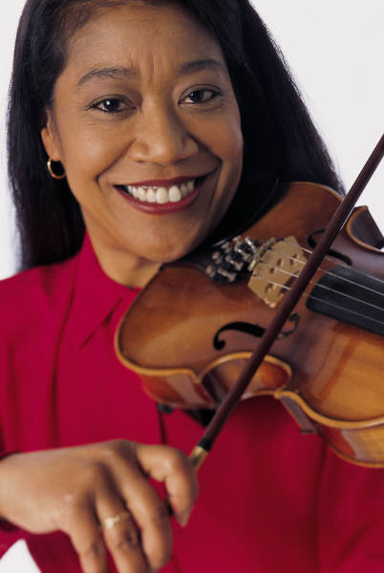

Engage
What is the difference between acquired and inherited traits?

Slide 3
What is heredity?
PPassing of traits from parent to offspring or from one generation to the next.
ssing of traits from parent to offspring or from oneeration to the next.
How are our traits determined?
Genes encode the instructions that define our traits.
Environmental factors influence the expression of these genes.

Slide 4
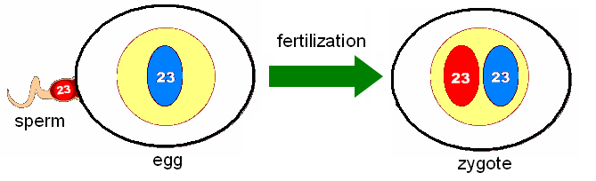
How are genes inherited?
Humans have 2 sets of chromosomes for a total of 46 chromosomes. Each parent contributes only 1 set of chromosomes to their child.
When a sperm cell (23 chromosomes) and an egg cell (23 chromosomes) join during fertilization, it results in a zygote … a fertilized egg with 46 chromosomes.

Slide 5
What is a trait?
Notable feature or quality in a person.
What are the two types of traits?
Physical traits are characteristics of one’s physical makeup Ex. Eye color
Behavioral traits characteristics of the way one acts. Ex. Fetching behavior of golden retrievers.

Slide 6
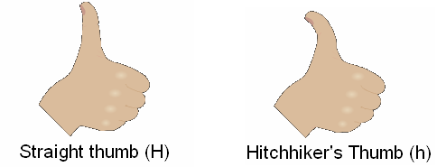
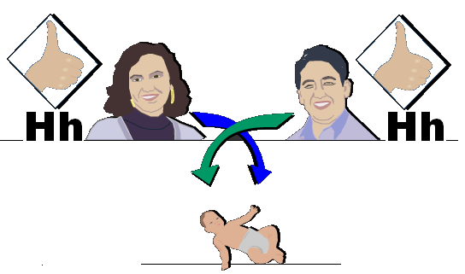
Gene = Trait.. From the DNA code
Alleles = Different forms of the same trait
*Parents can only give one allele for each trait to their offspring.

Slide 7

Gregor Mendel
Father of Genetics
Austrian Monk and gardener
He did experiments on Pea plants to show how traits were passed down
He studied the shape, seed color, outer coat, pea pod, and stem to see which traits occurred more or less often.
He was the first to observe:
  The Law of Independent Assortment
  The Law of Segregation

Slide 8




Mendel's Key Terms
The factors that carry all traits =
GENE
Two different forms of the same gene =
ALLELES

Slide 9
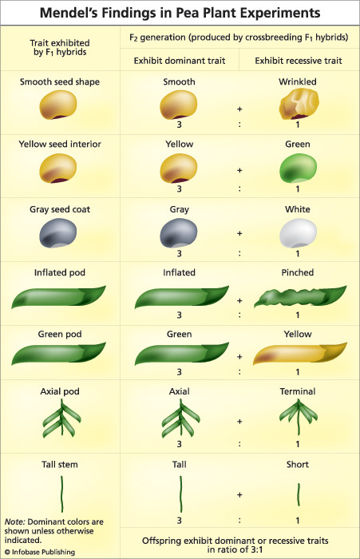

Slide 10
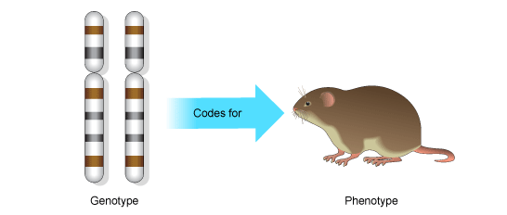
Genotype Phenotype
The genes of the organism
What the organism looks like

Slide 11
You inherit two alleles for each gene (trait).
1 from MOM! 1 from DAD!
Mendel's Key Terms
PHENOTYPE – physical characteristics that you SEE
Ex. Straight hair, red hair, freckles, lactose intolerant, tall, blue eyes
GENOTYPE – genetic makeup represented by letters
Ex. RR, Tt, Ff, gg, Yy, EePp

Slide 12
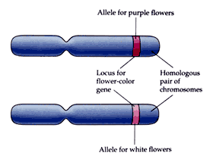
Allele – one or more versions of a gene.
    Located at a specific position on a specific chromosome
Dad’s
Dominant Allele Allele
  What will be expressed.
  It “masks” other alleles. Mom’s
  Written in upper case. Allele
Recessive Allele
  It will only be expressed if the dominant allele is not present.
  Written in lowercase.

Slide 13
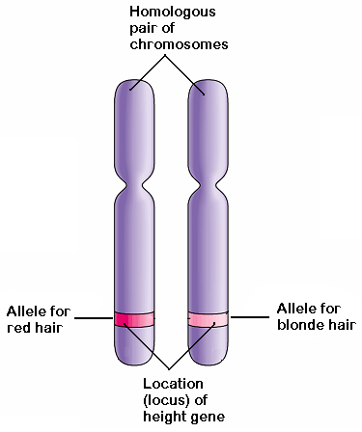
Paternal
Maternal

Slide 14
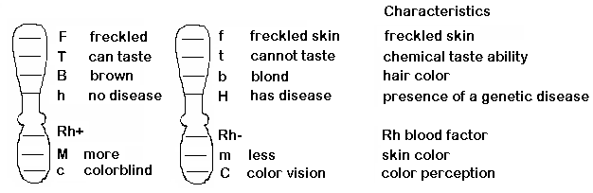
Genes on Chromosomes
Alleles – two forms of the same gene

Slide 15
Mendel’s Law of Heredity
Law of Complete Dominance: when there is a dominant allele and a recessive allele inherited together for a particular gene, the dominant allele will be expressed.
Red
R
r
Dominant
Red
hair
allele
Recessive
Blonde
hair
allele
Express the dominant allele for red hair

Slide 16
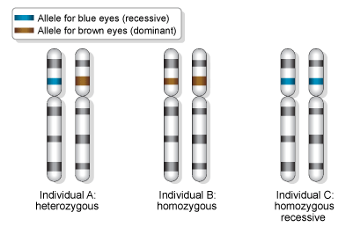
Heterozygous
  Hybrid
  Having 2 different alleles for a gene
Homozygous
  Same; purebred
  Have 2 of the same alleles for a gene

Slide 17
Mendel's Key Terms
R = Red hair r = Blonde hair
RR
Rr
rr
homozygous for Red hair
heterozygous for Red hair
homozygous for Blonde hair
When both alleles are the SAME it is called
When the alleles are DIFFERENT it is called
HOMOZYGOUS
HETEROZYGOUS

Slide 18
HYBRID- Same thing as a heterozygous
Yy
Purebred – same thing as Homozygous
YY or AA
yy or aa
Aa

Slide 19
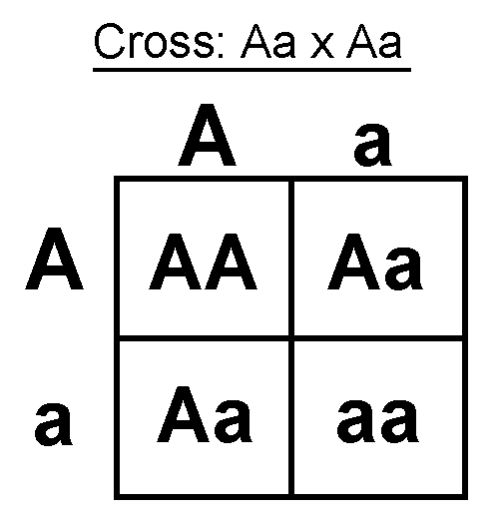
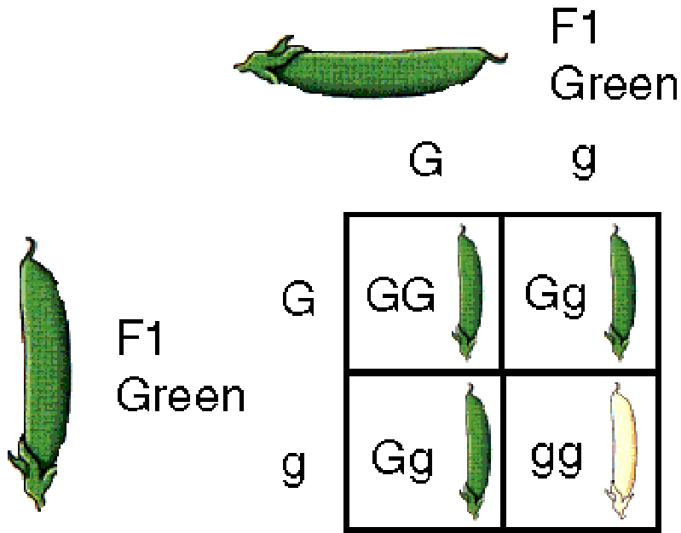
Punnett Squares
The diagram used to predict the genotype and phenotype.
Notes:
As a class do the Simpson’s genetics lab. Academic complete #1-4. Honors start @ #4.

Slide 20
Punnett Square
Each parent can only contribute one allele per gene.
These genes are found on the chromosomes carried in the sex cells.
Offspring will inherit 2 alleles to express that gene.
Male gametes
T
t
T
T T
T t
t
T t
t t
Female gametes

Slide 21
Punnett Squares
COMPLETE DOMINANCE - one allele is dominant to another allele
Steps to Solve Punnett Squares
Step 1: Assign letters for alleles (use a letter that have obvious capital and lowercase letters)
Step 2: Write down the cross by determining
the genotypes of the parents?
Step 3: Set up and solve the Punnett square.
Step 4: Answer questions, find ratios,
percentages or proportions.

Slide 22


Punnett Squares
RECALL MENDEL’S 1st EXPERIMENTS
CROSS: Purebred purple male x White female
P1 generation = PP x pp Male gametes
Female gametes
Genotypic ratio =
F1 generation
Phenotypic ratio =
P
P
p
Pp
Pp
p
Pp
Pp
1Pp
1 purple

Slide 23

Punnett Squares
Ex. You have 2 mice that are heterozygous for their brown coats.
Brown is the dominant color and white is the recessive. Create a Punnett Square that shows the cross between these two mice.
  B b
  B BB Bb
  b Bb bb
What are the ratios of genotypes you will get?
1 BB : 2 Bb : 1 bb
What percent of each phenotype will you see?
75% brown
25% white
Notes:
Simpson’s Genetics worksheet.
Academic do #1-4. Honors do #4 - ___

Slide 24
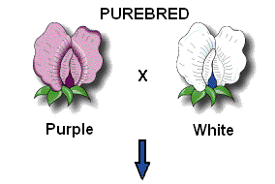
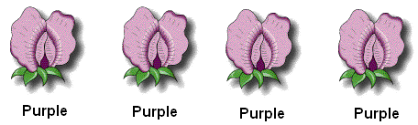
First Experiment
P1 generation
(parental generation)
F1 generation
(first generation)
Describe the results.
100% Purple
Notes:
Mendel’s First Experiment
He used purebred pea plants becausee they were easy to grow, had many characteristics to study, and they produced a lot of offspring.
P1 generation - parent generation --> pure Tall X pure short
F1 generation - filial genratiooon --> all Tall = 100% tall
It looked like the short trait disappeared! Where did it go? Was it hidden or eliminated?

Slide 25
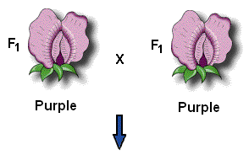
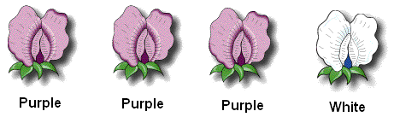
Second Experiment
F1 generation
(filial generation)
F2 generation:
(second generation)
Describe the results.
75% Purple and 25% White

Slide 26
Mendel’s 2nd Law of Inheritance
Law of Independent Assortment: the factors assort independently during gamete formation, giving different traits an equal opportunity of occurring together.
BT
sperm
BbTt
Bt
haploid (n)
bT
diploid (2n)
bt
meiosis II

Slide 27
Law of Segregation: during the production of gametes the two copies of each hereditary factor segregate so that offspring acquire- 1 from each parent.
Mendel’s 3rd Law of Inheritance
B
BB
sperm
B
BBbb
haploid (n)
diploid (2n)
b
bb
b
meiosis I
meiosis II

