Slide 2
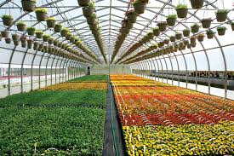
The Greenhouse Murder
You have been assigned to a Crime Scene Investigation Team to solve a nearby murder of a local business man.

Slide 3
Challenge
Who murdered Wyatt Grizzly?
Based on background information, formulate a hypothesis.
MATERIALS:
Flowers
Hand Lenses
Forceps
Scalpels
Metric Ruler
Small Dissecting Pan
Lab Notebook

Slide 4
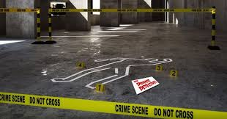
Mrs. Cowley
Two students will visit the Crime Scene in Room 2512 which depicts Wyatt Grizzly’s demise and read over the notes from the detectives. Take a picture of the crime scene to go into your final report. Record any key information in your notes. Then communicate back your findings to your investigative group.

Slide 5
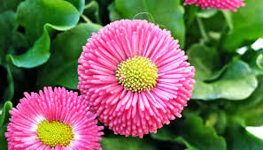
Ms. Honeycutt
Two members of your team will visit the local florist for a review tutorial on flower parts and identification (Room 516). Then communicate back to and teach their information to their investigative partner.

Slide 6
Some of the teams…
Will begin in Room 516 with the Flower tutorial and some will start in room 2512 with the Crime Scene overview.
Your teachers will tell you where your particular investigative team will start.

Slide 7
Investigative Teams- Blue (Cowley) Green (Honeycutt)
1. Avery T., Nataly
2. Avery K, Skylah
3. Mikaila, Jeda
4. Gabby, Kennedy
5. Kate, Zoe
6. Bridget, Dayana
7. Jaslyn, Jill, Aliyah
8. Olivia, JoAnn
9. Sydney, Ella
10. Anthony, Ethan
11. Aiden, Brody, Cole
12. Matt, Ryan
13. Chase, Evan, David
14. Luke, Carter
15. Spencer, Thomas, Will
16. Saleh, Xander, Nick
1. Nathan, Andrew
2. Ryan, Deven
3. Reese, Hannah
4. Isabella, Faith
5. Annabelle, Peyton
6. Ava, Ella O.
7. Brooke, Molly
8. Charlotte, Ella B.
9. Olivia, Kaitlyn
10. Grace, Haley
11. Abby L
12. Abby M., Graham
13. Ashely, Sarah
14. Leena, Palmer
15. Emma
16. Sam

Slide 8
Flower Lab
Review the parts of a flower.
Review the functions of each of the flower parts.
Read the flower dissection procedure and using your flower diagram, locate all of the parts you will be identifying on your diagram.
List those parts in your notebook and describe the function of each of those parts in your notebook.

Slide 9
Next Step...
After your team is familiar with the parts of a flower and you have a good understanding of the crime scene and background information… you will identify the flowers from the possible suspects’ delivery order using the dichotomous key given.
Two flowers are located in Room 2512 and two flowers are located in Room 516. You must correctly identify them in order to get them stamped by a teacher before you travel to the next room.

Slide 10
Finally…
Once your team has correctly identified or “validated” (by teacher’s stamps) the identity of the four flowers, obtain an evidence card from one of the teachers.
As a team, use all the evidence gathered to draw a conclusion on who the local sheriff should arrest for the murder of Wyatt Grisly. Write a cohesive paragraph citing specific scientific evidence on which to base your claim. Your summary will be sent to the Oregon State Police so make sure that it is presentable.

Slide 11
Final Report
Each group will submit a google document using the rubric given. Due date is Friday, Dec. 13th.
Your teachers are available during A lunch next week (Monday in room 516, Thursday in Room 2512, the other days in either room or during Husky Help on Wed. Dec. 11th.

Slide 12
Print, use and turn in the following rubric with your CSI report. Remember… this is a major grade☺

Slide 13
Contents and rubric
Names of CSI team members. (3 points)
Murder Scene Picture with specific notes of interest added. Include a list of suspects and how they are connected to Wyatt. (10 points)
Flower Diagram with parts and functions labelled.
(10 points)
Data Sheet with four flowers identified with both Scientific name written correctly and common name using the dichotomous key. (10 points)
Evidence Card with significant data noted (2 points)
Final summary paragraph to the Oregon State Police department explaining who should be arrested for the murder. Be sure to cite evidence from the crime scene and the flower identification to support your arrest warrant.
(15 points)

