Slide 1
Hair & Nails
Sam Schainblatt, Jessika Foland, Jalen Hurd, Paige Flanigon

Slide 2
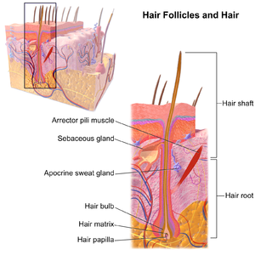
Root/Shaft/Follicle
Hair is made of keratinized cells that grow out of the epidermis. The strands of hair that originate in the dermis is called the hair follicle. The hair shaft (cortex and cuticle cells) is the part that is exposed at the skin's surface. What cannot be seen is the root of the hair.

Slide 3
Arrector Pili
This is a tiny muscle that attaches to the base of a hair follicle at one end and to dermal tissue on the other end.
In order to generate heat when the body is cold, the arrector pili muscles contract all at once, causing the hair to "stand up straight" on the skin.
The muscle is made up of a bundle of smooth muscle cells.
These muscle are considered vestigial because humans do not have enough hair for it to work. Body hairs other than eyebrows and facial hair are useless.

Slide 4
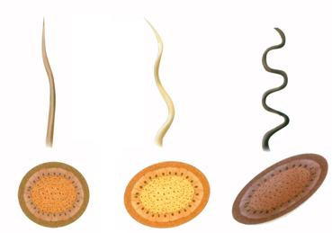
Hair Color and Texture
- Melanocytes around the matrix stem cells that produce the color of your hair (amount of melanin)
The more melanin you have the darker your hair.
-Curly hair comes from oval shaped follicles. Straight hair comes from round follicles. The oval shape follicles make it so that the hair strand is unevenly coated with keratin (this causes the coils of curly hair). Straight hair gets an even coating of keratin.

Slide 5
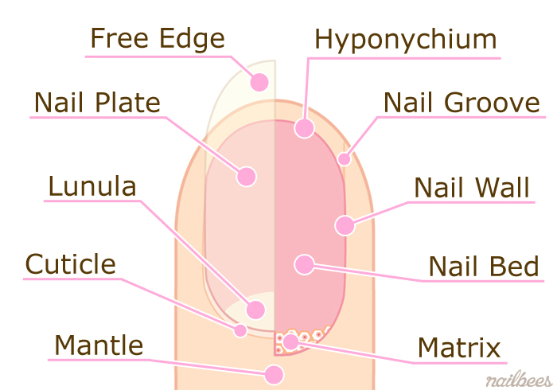
Nail Parts
Fingernails are made of living skin cells
Nails are largely made of keratin, a hardened protein
Nails have 10 parts
Nails grow from the Matrix
As cells grow they push out the old cells and form the nail
The nail plate is the part of the nail you can see
The lunula has stem cells which help the nail grow
The cuticle protects new nails from bacteria

Slide 6
Works Cited
Learning, Lumen. “Biology for Majors II.” Lumen, courses.lumenlearning.com/wm-biology2/chapter/hair/.
Kate. “Belgravia Centre Hair Loss Blog.” The Belgravia Centre, 2020, www.belgraviacentre.com/blog/hair-types-and-race-differences/.
https://www.medicinenet.com/image-collection/fingernail_anatomy_picture/picture.htm
https://www.quora.com/What-is-the-function-of-the-lunula
https://www.healthline.com/health/cuticle

