Slide 1
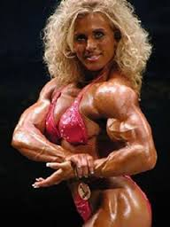
Unit 5 Muscular System Wrap-up

Slide 2
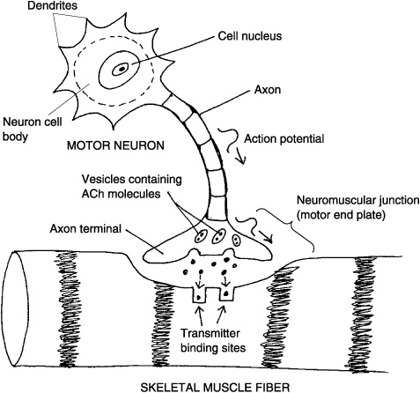
Review of Neuromuscular Junction

Slide 3
Review of Steps of Muscle Contraction Table 8.1 pg. 184
ACH binds to protein receptors
Increases permeability to Na⁺ ions which creates a muscle impulse
Increases permeability to Ca ⁺² ions causing troponin and tropomyosin to expose binding sites on actin
ACH-esterase(enzyme) decomposes the ACH to prevent further contraction
Ca⁺² goes back into sarcoplasmic reticulum breaking the link in actin and myosin

Slide 4
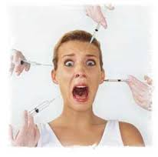
BOTOX???? Injections Video

Slide 5
How is botulism and botox related to the Muscular system? Pg.183
Creates paralyzing of facial muscles …
Clostridium botulism (bacterium) makes toxins that prevent the release of ACH…no contraction
Why do body builders use Creatine?
Creatine phosphate enables ATP to be regenerated from ADT and phosphate (stores excess energy released from Mitochondria)
Myoglobin=can temporarily store Oxygen which decreases muscle requirement for continuous blood supply during muscle contraction
Fatigue= muscle exercised strenuously for a prolonged period of time → loses its ability to contract due to increase in lactic acid from anaerobic respiration

Slide 6
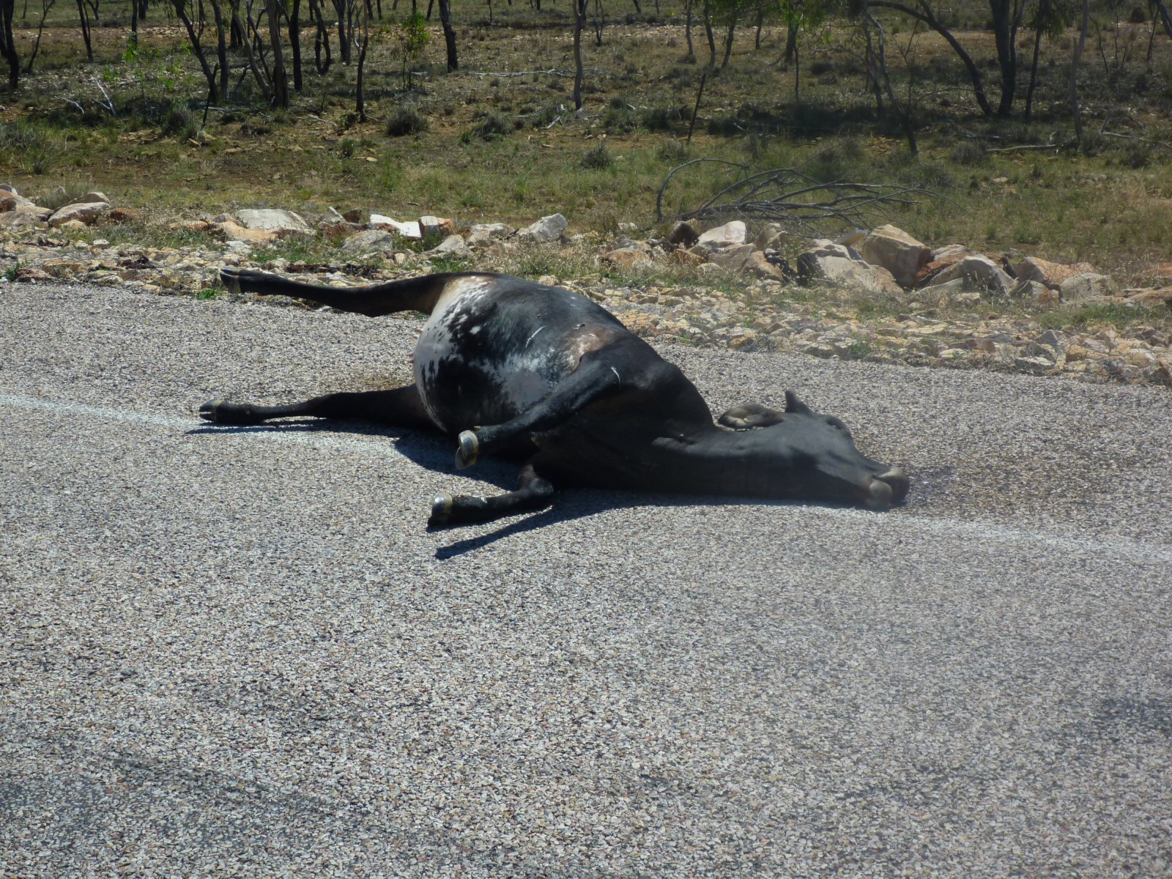
Rigor Mortis- Animation

Slide 7
MORE Muscle tidbits…
Cramps→ muscle undergoes a sustained involuntary contraction, this occurs when there is a change in extracellular fluid surrounding the muscle fiber and the motor neuron is somehow triggered which results in an uncontrolled stimulation of muscle
Rigor mortis→ after death, partial contraction, increase in Ca⁺² and decrease in ATP, prevents relaxation, actin and myosin remain linked until muscles decompose.
Heat production → of muscle helps maintain body
temperature.
Frog experiment in College---- Ca ⁺²to quadriceps of frog
Muscular responses—fast twitch vs. slow twitch fibers
Olympic sprinter = 80% fast Marathoner = 90% slow twitch
Average person = 50% fast / 50% slow

Slide 8
Contractions→ how do you hold a cup of coffee without crushing it??
IT all has to do with…
a) Frequency of muscle stimulation b) how many fibers take part
Muscular hypertrophy (big) vs. atrophy (decrease in size and strength)
Lower intensity exercises like swimming and running require more mitochondria and more blood flow to resist fatigue
Forceful exercise → wt. lifting uses more fast twitch , creates more actin and myosin which increases the size of the muscle

Slide 9
Strength of muscle contraction is directly proportional to the diameter of the activated muscle fiber
When you stop exercising… process reverses and atrophy ….can shrink to half the size in a few months)
Summation = individual twitches together
Tetanus= sustained contraction (lacks partial relaxation)
Recruitment= increase in # of motor units being activated
Sustained contractions = summation + recruitment
Muscle tone = sustained contraction, helps with posture, collapses with loss of consciousness

Slide 10
Other types of muscle…
1. Smooth Muscle = iris of eyes and blood vessels … only respond to hormones and motor nerve impulses
Peristalsis = one muscle stimulated triggers the one next to it… creates a rythmic wavelike motion…pushes food through the intestines
2. Cardiac= has intercalated discs … a network of cells contract as one unit

Slide 11
Genetic Connection--- Muscular diseases pg. 191
Muscular Dystrophy
Muscular Dystrophy—missing proteins(vary in age and onset)
Dystrophin = holds skeletal muscle together (linking actin in the cell)…muscle weakens and degenerates and is replaced by fat and connective tissue
Duchennes—only boys…. Onset is about the age of 5 -- die from failure of respiratory muscles

Slide 12
More muscular diseases…
Charcot Marie Tooth Disease -- decrease in mov’t. of hands and feet and tendon reflexes… extra gene impairs the insulating sheath of nerves→ can’t stimulate muscle
Myotonic = expanding gene through generations … delays muscle relaxation… gets worse from F1 to F4
HIDC= a tiny glitch, change in DNA → actin can’t anchor to Z lines in heart muscle, heart chamber enlarges and eventually fails
Post Polio Syndrome / Acute paralytic poliomyelitis (polio) → a viral infection that can spread to the spinal cord which in turn controls muscle contractions → paralyzed
Now a problem in Africa (Nigeria).. was once almost eradicated.

