Slide 1
Organic Molecules
Polymers with Carbon

Slide 2
Polymers

Slide 3
Polymers and Monomers
Dehydration synthesis: creating a polymer and water
Hydrolysis: breaking down a polymer using water
Animations

Slide 4
Carbohydrates: monosaccharides and disaccharides

Slide 5
Carbohydrates: Polysaccharides Starch

Slide 6
Carbohydrates
Monomers: monosaccharides (simple sugars)
Polymers: polysaccharides
Starch (in plants)
Glycogen (in animals)
Fiber (cellulose in plants for cell walls)
Function:
Short term energy
Cell wall structure

Slide 7
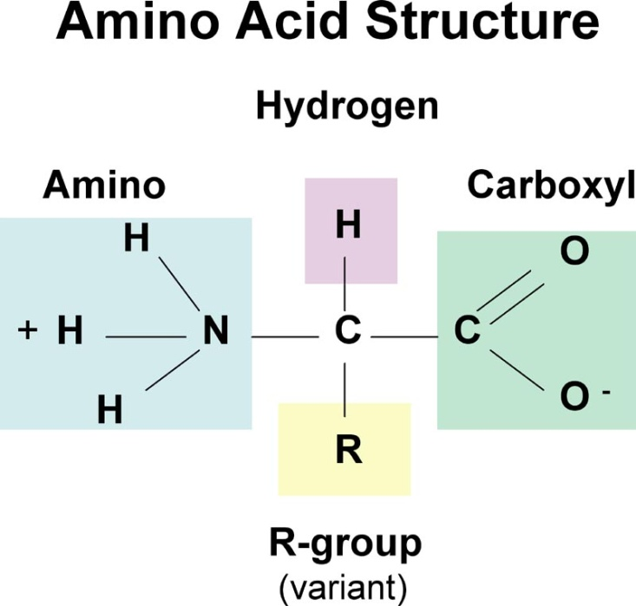
Proteins
Monomer: Amino acids
There are 20 different
amino acids
Polymers: All kinds of
structural and functional proteins with special functions: enzymes,collagen, elastin, keratin, hemoglobin (polypeptides)
Enzymes speed up chemical reactions
Pictures of proteins

Slide 8
Lipids
Monomers: glycerol, fatty acids
Polymers:
Fats
Oils
Waxes
Functions:
Long term energy storage
Water-proofing
Insulation
Cell membrane structure
Cushioning

Slide 9
Saturated v. Unsaturated
Saturated Fats:
no double bonds, straight structure, more likely to clog arteries
Unsaturated fats:
double bonds, bent structure, less likely to clog arteries

Slide 10
Lipids

Slide 11
Nucleic Acids
Monomer: nucleotides
Polymers: DNA and RNA
Function: contain the code for proteins

Slide 12
Nucleotides

Slide 13
Draw a mark at the midpoint of a sheet of paper along the side edge.
Then fold the top and bottom edges in to touch the midpoint.
To return to the chapter summary click escape or close this document.

Slide 14
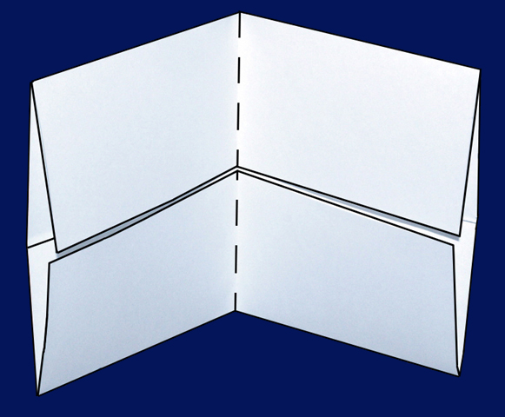
Fold in half from side to side.
To return to the chapter summary click escape or close this document.

Slide 15
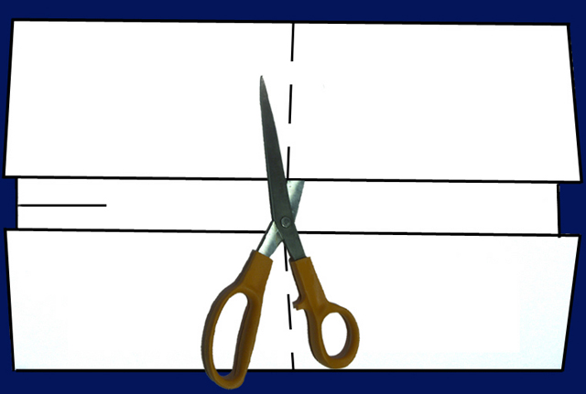
Open and cut along the inside fold lines to form four tabs.
To return to the chapter summary click escape or close this document.

Slide 16
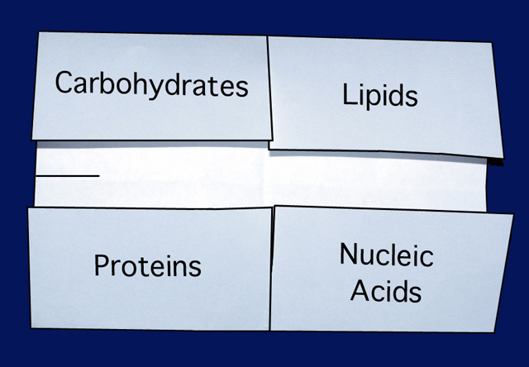
Label each tab.
To return to the chapter summary click escape or close this document.

