Slide 1
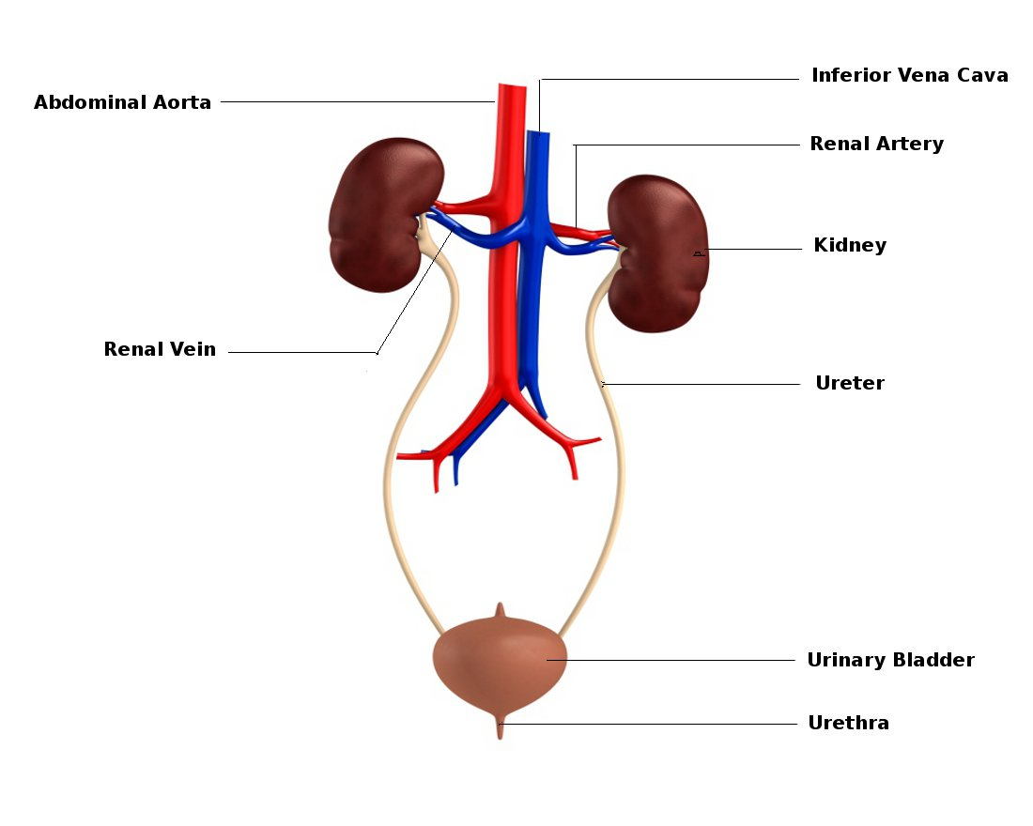
Urinary System →
to rid the body of N₂ while regulating electrolyte balance and acid/ base balance of blood

Slide 2
Introduction…Watch video linked below
Urinary System

Slide 3
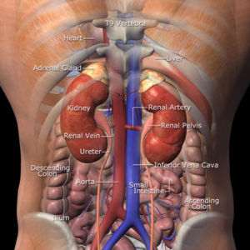
Kidneys – homeostatic organs, located on dorsal wall beneath pareital peritoneum
small dark red organs with kidney bean shape
get some protection from lower ribs
rt. kidney slightly lower
12 ½ cm. long and 2 ½ cm
thick (large bar of soap)
convex with Hilus = where
blood vessels go in & out

Slide 4
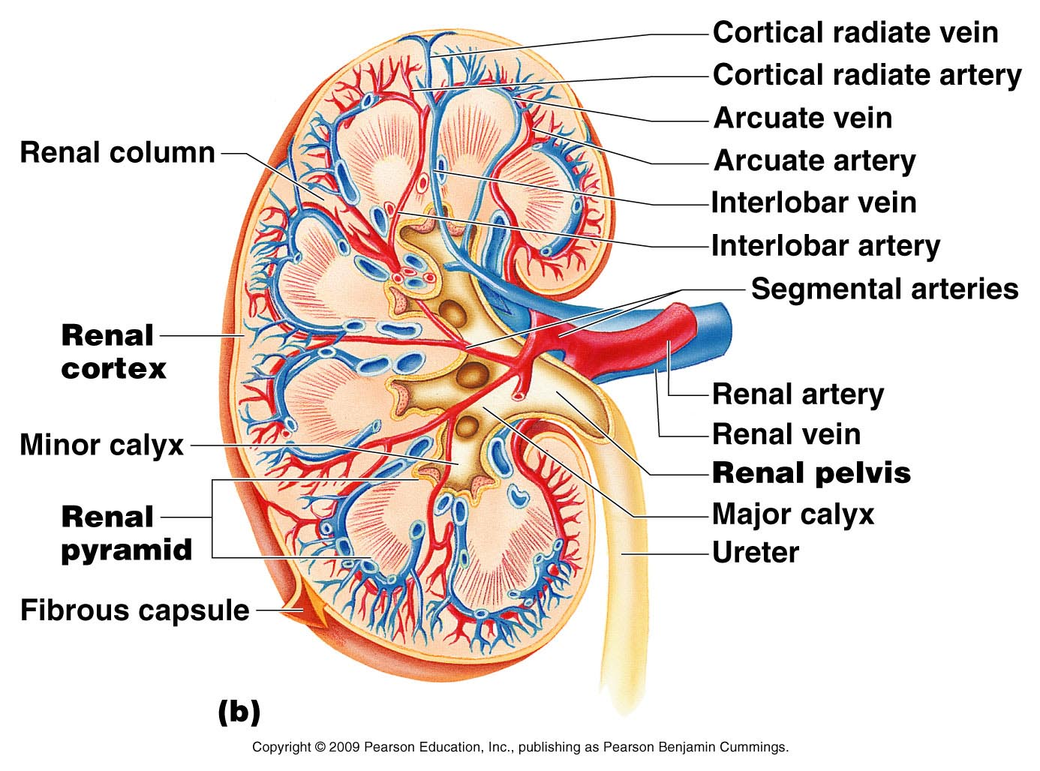
Kidneys continued!
adrenal gland is on top (endocrine system)
renal capsule = transparent covering
adipose capsule = surrounds, protects, & holds it in place
filter gallons of fluid everyday!
Produce enzyme renin to
regulate blood pressure, and
regulates RBC production by
producing erythropoietin
Also converts Vit. D to active
form

Slide 5
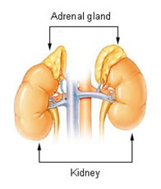
Problems with the Kidneys
** ptosis = kidneys drop (if loose a lot of weight) → ureters become kinked → puts pressure on kidneys = hydronephrosis
Cross section has 3 distinct regions
renal cortex = outer layer (bark)
renal medulla = darker, has triangular
regions
* tip of triangle is called the apex
* renal columns are even lighter
* renal pelvis → goes to the ureter
* extensions of pelvis are called calyces (cup-like collective areas)
** very rich blood supply !, ¼ of all blood passes thru kidney each minute!
Renal artery → and all the smaller ones
Returns thru veins of the same name

Slide 6
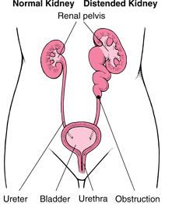
Ptosis of the Kidneys

Slide 7
Urination…. Watch video linked below
Urination reflex (Micturition)

Slide 8
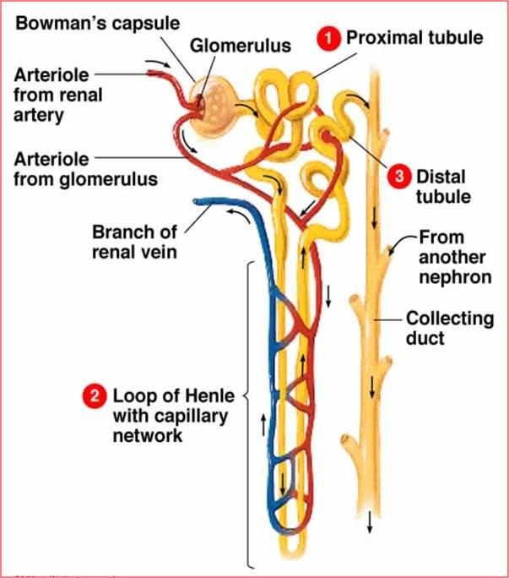
Nephron = major filtering unit; each kidney has 1 million
Glomerulus = knot in capillaries
1. Renal tubule → proximal convuluted
tubule to the
2. Bowman’s capsule/ glomerulus →
coils and twists before becoming
a hairpin loop
3. Loop of Henle) → then to the
4. distal convuluted tubule →
5. collecting tubule
Afferent (into)arterioles = hi pressure
Efferent (out of)arterioles= low pressure
U system also has two ureters, urinary bladder and a urethra

Slide 9
Urinary System Drawings…
Draw color label and title
Fig. 17.1 The Urinary System pg. 470.
Fig. 17.2 The Kidney, Renal Pyramid and Nephron pg. 471

